Slide 1
UMD DATA605 - Big Data Systems (Apache) Spark
GP Saggese
gsaggese@umd.edu
with thanks to Alan Sussman, Amol Deshpande,
David Wheeler (GMU), T. Yang (UCSB) and Apache documentation

Slide 2
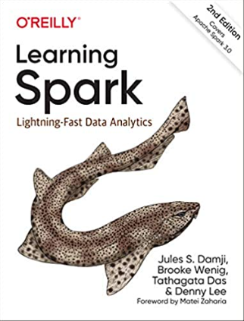
Apache Spark - Resources
Mastery: Learning Spark: Lightning-Fast Data Analytics 2nd Edition
Free version here
Web resources:
https://spark.apache.org/docs/latest/rdd-programming-guide.html
https://cacm.acm.org/magazines/2016/11/209116-apache-spark/fulltext

Slide 3
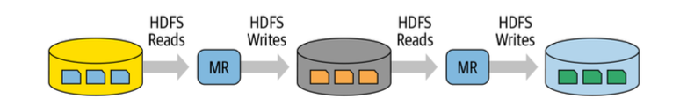
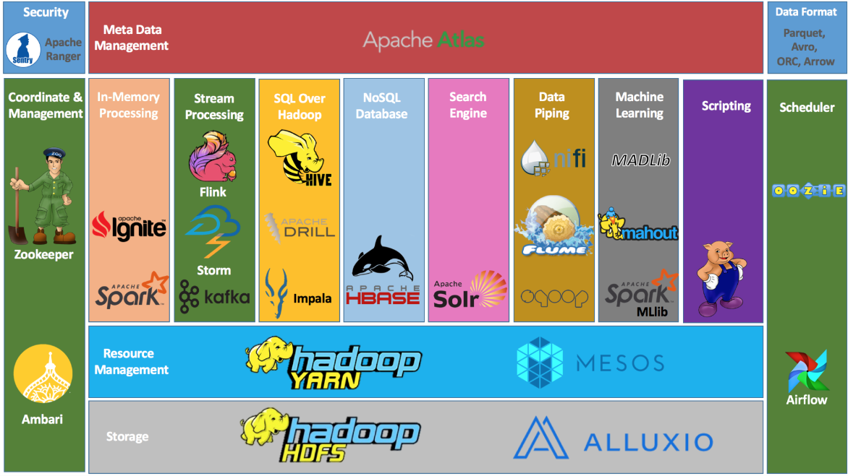
Hadoop MapReduce Shortcomings
Hard to manage and administer
Batch processing API verbose
Interaction between MapReduce tasks requires data to be written on disk
Large but fragmented ecosystem
No native support for machine learning, SQL, streaming, interactive computing
To handle new workloads engineers developed new systems on top of Hadoop
E.g., Apache Hive, Storm, Impala, Giraph, Drill

Slide 4
Apache Spark
Open source
General processing engine
Instead of just Map() and Reduce(), define a large set of operations
Operations can be arbitrarily combined in any order
Transformations vs actions
Computation is organized as DAG
DAGs are decomposed into tasks that can run in parallel
Scheduler / optimizer on parallel workers
Supports Java, Scala, and Python
Key abstraction: Resilient Distributed Dataset (RDD)
Data structures like DataFrames, Datasets built on top of RDD
Fault tolerance through RDD lineage
In-memory computation
All intermediate results are kept in memory instead of disk
Persist data on disk or in memory

Slide 5
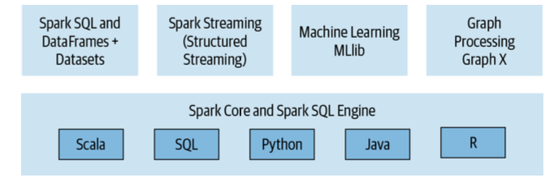
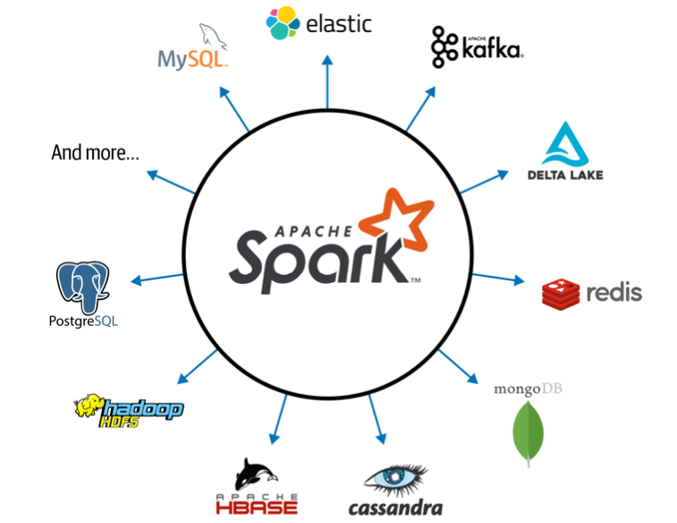
Apache Spark
Unified stack
Different computation models in a single framework
Spark SQL
ANSI SQL compliant
Work with structured relational data
Spark MLlib
Popular ML algorithms
Build ML pipelines
Built on top of Spark DataFrame
Spark Streaming
Handle continually growing tables
Tables are treated as static table
GraphX
Manipulate graphs
Perform graph-parallel computation
Extensibility
Read from a myriad of sources
Write to many backends

Slide 6
Resilient Distributed Dataset (RDD)
An RDD is a collection of elements:
fault-tolerant
partitioned across nodes
that can be operated on in parallel
RDDs represent data or transformations on data
Ways to create RDDs
parallelize an existing collection in your driver program
reference data in an external storage system, e.g., a file-system, HDFS, HBase
transform other RDDs
Transformations
Lazy evaluation: nothing computed until an action requires it
Actions
When applied to RDDs force calculations and return values
RDDs
Best suited for applications that apply the same operation to all elements of a dataset
Less suitable for applications that make asynchronous fine-grained updates to shared state

Slide 7
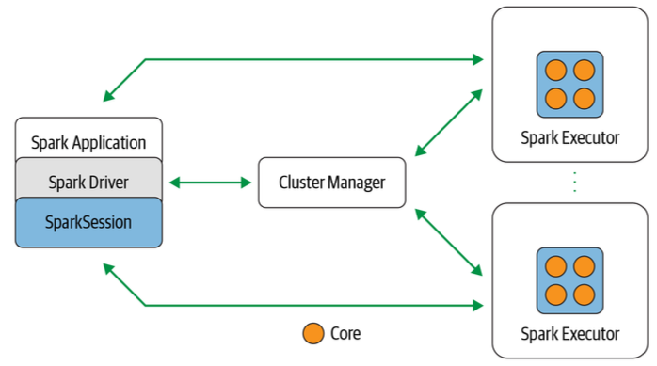
Spark Architecture
Spark Application
What the user writes to describe the computation
Spark Driver
Instantiate a SparkSession
Communicate with cluster manager
Request resources from the Cluster Manager
Transform operations into DAG computations
Distribute execution of tasks across Spark executors
SparkSession
Represent the interface to Spark system
Cluster Manager
Manage and allocate resources
Support Hadoop, YARN, Mesos, Kubernetes
Spark executor
Run a worker node to execute tasks
JVM
Typically one executor per node

Slide 8
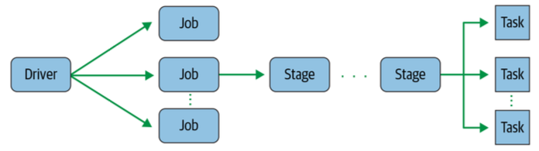
Application Concepts
Spark Driver
The driver converts the Spark application in one or more Jobs
Spark Job
A parallel computation that runs in response to a Spark action (e.g., `save()`, `collect()`)
Each Job becomes a DAG containing one or more Stages
Spark Stage
Each Job is divided in smaller tasks called Stages that depend on each other
Stages can be performed serially or in parallel
Spark Task
A single unit of work sent to a Spark Executor
Each Stage is comprised of multiple Tasks
Each Task maps to a single core and works on a single partition of data

Slide 9
Deployment Modes
Spark can run on many different configurations
Local
E.g., run on your laptop
Driver, Cluster Manager, Executor all run in a single JVM on the same node
Standalone
Driver, Cluster Manager, Executor run in different JVMs on different nodes
YARN
Kubernetes
Driver, Cluster Manager, Executor run on different pods (i.e., containers)

Slide 10
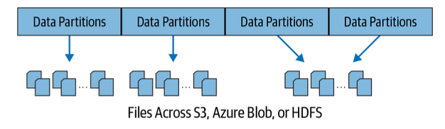
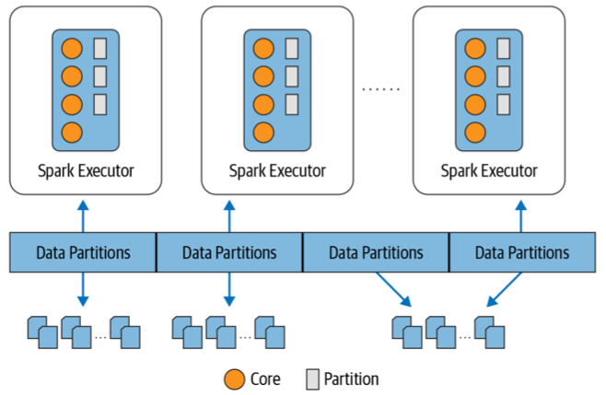
Distributed Data and Partitions
Data is distributed as partitions across different physical nodes
Each partition is typically stored in memory
Partitioning allows efficient parallelism
Spark Executors process data that is “close” to them
Minimize network bandwidth
Data locality

Slide 11
Parallelized Collections
Parallelized collections are created by calling SparkContext’s `parallelize()` method on an existing iterable or collection
Important parameter for parallel collections is the number of partitions to cut the dataset into
Spark will run one task for each partition of the cluster
Typically you want 2-4 partitions for each CPU in your cluster
Spark tries to set the number of partitions automatically based on your cluster
But you can also set it manually by passing it as a second parameter to parallelize

Slide 12
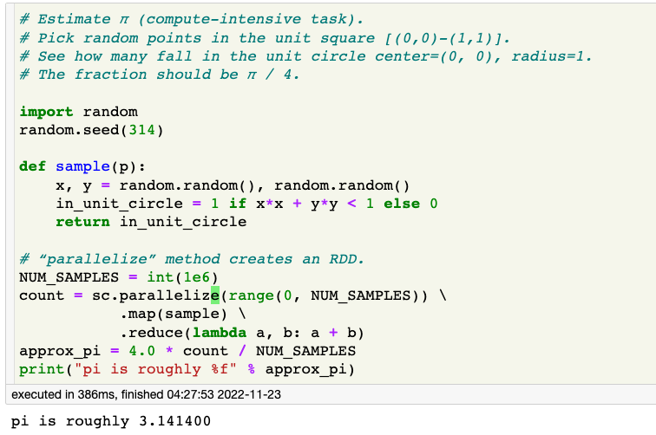
Spark Example #1
Notes:
# Estimate π (compute-intensive task).
# Pick random points in the unit square [(0,0)-(1,1)].
# See how many fall in the unit circle center=(0, 0), radius=1.
# The fraction should be π / 4.
import random
random.seed(314)
def sample(p):
x, y = random.random(), random.random()
in_unit_circle = 1 if x*x + y*y < 1 else 0
return in_unit_circle
# “parallelize” method creates an RDD.
NUM_SAMPLES = int(10 * 1e6)
count = sc.parallelize(range(0, NUM_SAMPLES)) \
.map(sample) \
.reduce(lambda a, b: a + b)
approx_pi = 4.0 * count / NUM_SAMPLES
print("pi is roughly %f" % approx_pi)

Slide 13
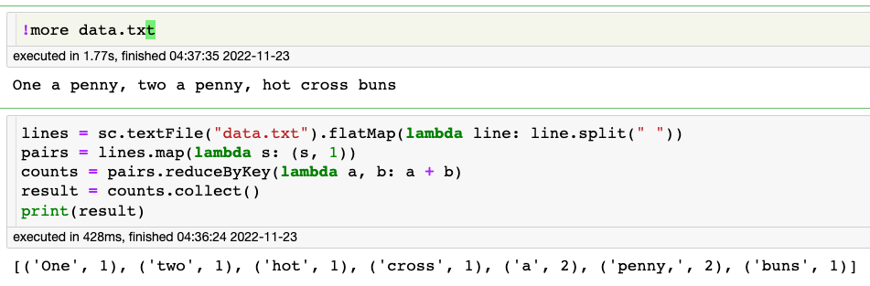
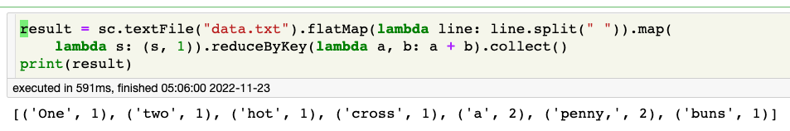
Spark Example #2
MapReduce in X lines where X is [1, 5]

Slide 14
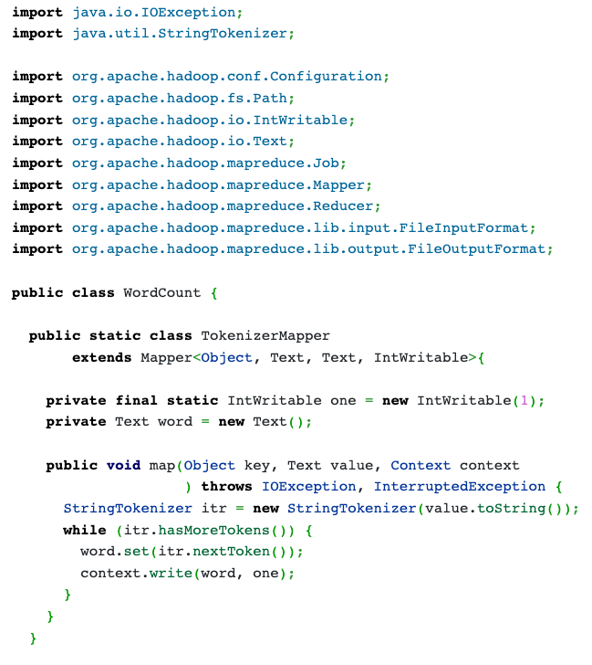
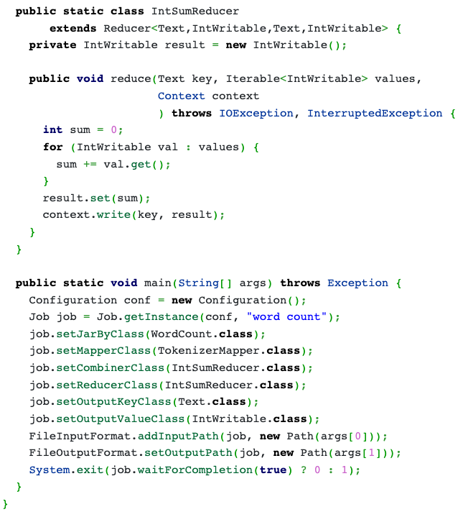
Same Code in Java Hadoop

Slide 15
Transformations vs Actions
Transformations
Transform a Spark RDD into a new RDD, without modifying the input data (immutability)
E.g., `select()`, `filter()`, `join()`, `orderBy()`
Transformations are evaluated lazily
Results are recorded as "lineage", i.e., a sequence of stages that can be rearranged, optimized
Lazy execution allows to inspect computation and decide how to optimize it
E.g., joining, pipeline operations, breaking into stages
Action
An action triggers the lazy evaluation
E.g., `show()`, `take()`, `count()`, `collect()`, `save()`
Fault tolerance
Spark uses immutability and lineage to provide fault tolerance
In case of failure, a RDD can be reproduced by simply replaying the recorded lineage

Slide 16
Spark Transformations
map(func)
Return a new RDD formed by passing each element of the source through a function func()
flatmap(func)
Similar to map, but each input item can be mapped to 0 or more output items
So func() should return a Seq rather than a single item
filter(func)
Return a new RDD formed by selecting those elements of the source on which func returns true
union(otherDataset)
Return a new RDD that contains the union of the elements in the source dataset and the argument
intersection(otherDataset)
Return a new RDD that contains the intersection of elements in the source dataset and the argument
https://spark.apache.org/docs/latest/rdd-programming-guide.html

Slide 17
Spark Transformations
distinct([numTasks]))
Return a new RDD that contains the distinct elements of the source dataset
join(otherDataset, [numTasks]):
When called on RDDs (K, V) and (K, W), returns a dataset of (K, (V, W)) pairs with all pairs of elements for each key
Outer joins are supported through leftOuterJoin, rightOuterJoin, and fullOuterJoin.
cogroup(otherDataset, [numPartitions])
When called on RDD of type (K, V) and (K, W), returns a dataset of (K, (Iterable<V>, Iterable<W>)) tuples
This operation is also called groupWith.

Slide 18
Spark Transformations
groupByKey([numPartitions])
When called on a RDD of (K, V) pairs, return a dataset of (K, Iterable<V>) pairs
If you are grouping in order to perform an aggregation (such as a sum or average) over each key, reduceByKey or aggregateByKey will yield much better performance
By default, the level of parallelism in the output depends on the number of partitions of the parent RDD. You can pass an optional numPartitions argument to set a different number of tasks
reduceByKey(func, [numPartitions])
When called on a RDD of (K, V) pairs, returns a dataset of (K, V) pairs where the values for each key are aggregated using the given reduce function func, which must be of type (V,V) => V.
Like in groupByKey, the number of reduce tasks is configurable through an optional second argument

Slide 19
Spark Transformations
aggregateByKey(zeroValue)(seqOp, combOp, [numPartitions])
When called on a dataset of (K, V) pairs, returns a dataset of (K, U) pairs where the values for each key are aggregated using the given combine functions and a neutral "zero" value.
Allows an aggregated value type that is different than the input value type, while avoiding unnecessary allocations
sortByKey([ascending], [numPartitions])
When called on a dataset of (K, V) pairs where K implements Ordered, returns a dataset of (K, V) pairs sorted by keys in ascending or descending order, as specified in the boolean ascending argument.
...

Slide 20
Spark Actions
reduce(func)
Aggregate the elements of the dataset using a function func()
func() takes two arguments and returns one
func() should be commutative and associative so that it can be computed correctly in parallel
collect()
Return all the elements of the dataset as an array
This is usually useful after a filter or other operation that returns a sufficiently small subset of the data
count()
Return the number of elements in the dataset
take(n)
Return an array with the first n elements of the dataset
https://spark.apache.org/docs/latest/rdd-programming-guide.html

Slide 21
Spark: RDD Persistence
RDDs automatically recover from node failure, with no assistance from user
You can explicitly persist (aka cache) an RDD calling persist() or cache() on it
When you persist an RDD, each node
stores in memory any partitions of the RDD that it computes
reuses in other actions on that dataset (or datasets derived from it)
Allows future actions to be much faster (often >10x).
Cache is fault-tolerant
if any partition of an RDD is lost, it will automatically be recomputed using the transformations that originally created it
Can choose storage level, e.g.,
MEMORY_ONLY (default)
DISK_ONLY (e.g., pickle)
MEMORY_AND_DISK
Cache is managed by Spark with an LRU policy + garbage collector
Can manually call unpersist()

Slide 22
Spark Shuffle
Certain Spark operations trigger a "data shuffle"
E.g., reduceByKey, groupByKey, join, repartition
Data shuffle = re-distribute data grouped differently across partitions
E.g., `reduceByKey` all values for a single key are combined into a tuple (k, v) where v is the result of applying a reduce functions to all values associated with that key
Problem: all the values for a single key need to reside on the same partition / machine
Shuffle is expensive since it involves:
data serialization (pickle)
disk I/O (save to disk)
network I/O (copy across Executors)

Slide 23





















Under the Hood
General task graphs
Automatically pipelines functions
Data locality aware
Partitioning aware to avoid shuffles
A:
B:
F:
Stage 1
groupBy
C:
D:
E:
join
Stage 2
map
filter
Stage 3
= RDD
= cached partition

Slide 24
Spark Example #3 (Python)
# Logistic Regression - iterative machine learning algorithm
# Find best hyperplane that separates two sets of points in a
# multi-dimensional feature space. Applies MapReduce operation
# repeatedly to the same dataset, so it benefits greatly
# from caching the input in RAM
points = spark.textFile(...).map(parsePoint).cache()
w = numpy.random.ranf(size = D) # current separating plane
for i in range(ITERATIONS):
gradient = points.map(
lambda p: (1 / (1 + exp(-p.y*(w.dot(p.x)))) - 1) * p.y * p.x
).reduce(lambda a, b: a + b)
w -= gradient
print "Final separating plane: %s" % w
https://spark.apache.org/docs/latest/quick-start.html

Slide 25
Broadcast variables
Allow keeping a read-only variable cached on each machine in the cluster, instead of shipping with tasks
e.g., to give every node a copy of a large input dataset
Can use efficient broadcast algorithms to reduce communication costs
Broadcast variable created and used like this:
>>> broadcastVar = sc.broadcast([1, 2, 3]) <pyspark.broadcast.Broadcast object at 0x102789f10>
>>> broadcastVar.value
[1, 2, 3]

Slide 26
Accumulators
Variables that are only “added” to through an associative and commutative operation
so be efficiently supported in parallel
Can be used to implement counters (as in MapReduce) or sums
Spark natively supports accumulators of numeric types, and programmers can add support for new types
Example of accumulator used to sum elements in an array:
>>> accum = sc.accumulator(0)
>>> accum
Accumulator<id=0, value=0>
>>> sc.parallelize([1, 2, 3, 4]).foreach(lambda x: accum.add(x))
...
10/09/29 18:41:08 INFO SparkContext: Tasks finished in 0.317106 s
>>> accum.value
10

Slide 27
Apache Spark: Libraries “on top” of core that come with it
Spark SQL – for structured data processing
Datasets for distributed data collections
DataFrames for Datasets organized into named columns (tables!)
Spark Streaming – stream processing of live datastreams
MLlib - machine learning library - DataFrame-based API is now primary API (means no new features for RDDs)
GraphX – graph manipulation
extends Spark RDD with Graph abstraction: a directed multigraph with properties attached to each vertex and edge
SparkR – lightweight frontend to use Spark from R
distributed DataFrame operations on large datasets

Slide 28
Gray sort competition: Winner Spark-based (previously Hadoop)
 | Hadoop MR Record | Spark Record (2014)
Data Size | 102.5 TB | 100 TB
Elapsed Time | 72 mins | 23 mins
# Nodes | 2100 | 206
# Cores | 50400 physical | 6592 virtualized
Cluster disk throughput | 3150 GB/s (est.) | 618 GB/s
Network | dedicated data center, 10Gbps | virtualized (EC2) 10Gbps network
Sort rate | 1.42 TB/min | 4.27 TB/min
Sort rate/node | 0.67 GB/min | 20.7 GB/min
Spark-based
System
3x faster
with 1/10
# of nodes
Sort benchmark, Daytona Gray: sort of 100 TB of data (1 trillion records)
http://databricks.com/blog/2014/11/05/spark-officially-sets-a-new-record-in-large-scale-sorting.html

Slide 29
Spark vs. Hadoop MapReduce
Performance: Spark normally faster but with caveats
Spark can process data in-memory; Hadoop MapReduce persists back to the disk after a map or reduce action
Spark generally outperforms MapReduce, but it often needs lots of memory to do well; if there are other resource-demanding services or can’t fit in memory, Spark degrades
MapReduce easily runs alongside other services with minor performance differences, & works well with the 1-pass jobs it was designed for
Ease of use: Spark is easier to program
Data processing: Spark more general
“Spark vs. Hadoop MapReduce” by Saggi Neumann (November 24, 2014)
https://www.xplenty.com/blog/2014/11/apache-spark-vs-hadoop-mapreduce/

Slide 30
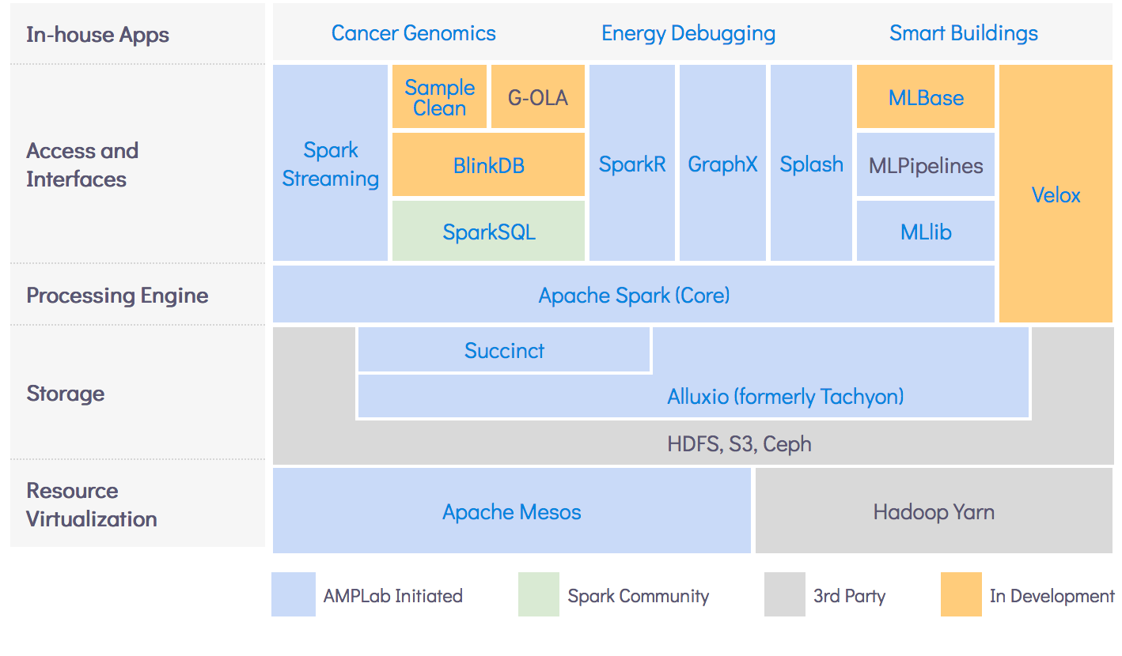
AMPLab’s Berkeley Data Analytics Stack (BDAS)
https://amplab.cs.berkeley.edu/software/

Slide 31
For more information
More Spark examples at http://spark.apache.org/examples.html
Spark Coursera tutorial in Python
https://www.coursera.org/learn/big-data-essentials/lecture/o6oKt/getting-started-with-spark-python
“Resilient Distributed Datasets: A Fault-Tolerant Abstraction for In-Memory Cluster Computing” by Matei Zaharia et. al
http://people.csail.mit.edu/matei/papers/2012/nsdi_spark.pdf
Other Spark papers listed at
https://spark.apache.org/research.html

